Slide 1
Kotlin CONT.

Slide 2
TOPICS
“if” statements
Nested “if”s
“when” statements
“AND”, “OR”
Comments!

Slide 3
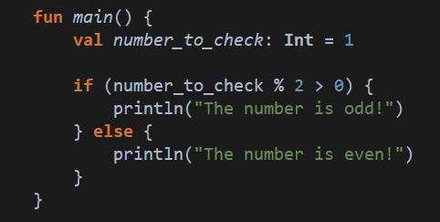

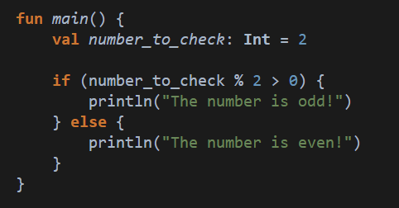

If?
Checking whether the number has a remainder when dividing by 2!
Odd
Correct output!
Making the computer think!
Used to make decide something based on input.
Even
Check for remainder…
Correct output!

Slide 4
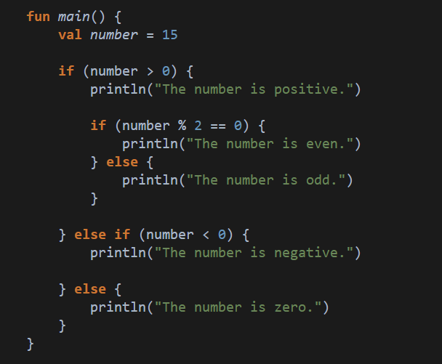

Nested IF
Positive, Odd
First check if
the number positive…
If it is, then check if its odd or even
“if” inside “if” inside “if”…
If it isn’t, check if its negative…
You can stack as many inside each other as you need!
Try not to stack too many though, makes it complicated to read…
Finally, if its neither, it has to be 0!

Slide 5
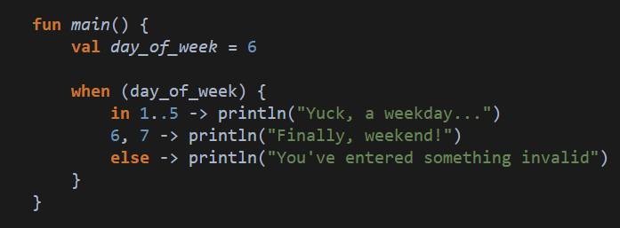
WHEN
Another way to decide!
Similar to “if” “else”, but a nicer way to read if you have more than 3 options.
YOU get to decide which you’d like to use (unless a rubric specifies otherwise!)
“if” between 1 and 5
“if” 6 or 7
“else”…

Slide 6
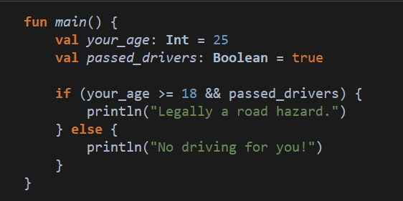

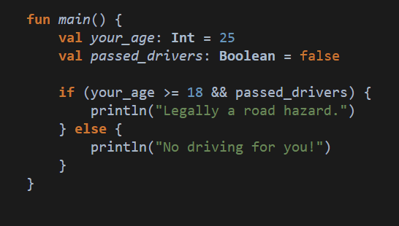

AND
Only valid if both are true
It works like you’d expect
Represented by &&
You can chain as many as you’d like together.
No longer true
Output changed!

Slide 7
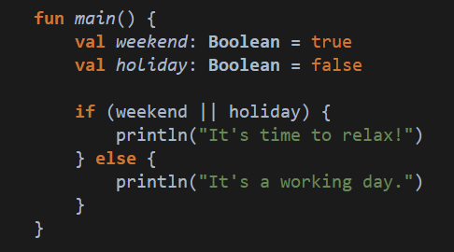

OR
Notice how only weekend is true!
Also works how you’d expect
Because we used “or”, only one condition has to be true
Represented by ||
(hold shift and press \)
Can also use as many as you’d like together, even in combination with “AND” (&&)
Even though its only weekend, but not holiday, we can still relax 😎

Slide 8
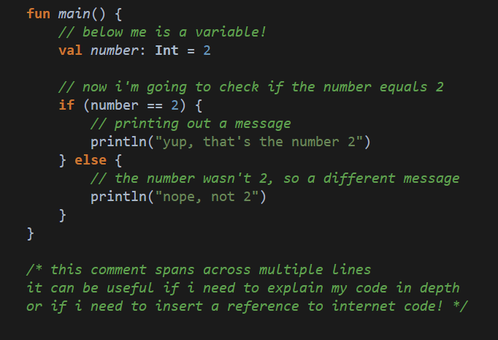
Comments
Leave yourself a message, in code!
Add them anywhere by putting // before the line
You can cover multiple lines in one go by using

Slide 9
Your Turn…
Write code that stores the length and width of a rectangle (you can choose the sizes) in variables.
Using these variables, calculate:
The perimeter (2 * length + 2 * width)
The area (length * width)
THEN
Check whether the area is bigger, smaller, or equal to the perimeter, and print out a message.
Add comments to explain your logic as you go!
FEEL FREE TO REUSE YOUR ANSWER FROM LAST WEEK

Slide 10
YOUR TURN AGAIN…
Write a small program for your local gym to help calculate the BMI of users.
You need the weight in kilograms (kg), and height in metres.
The calculation for BMI is weight/height^2
(weight divided by height squared)
Based on the answer to the calculation, print out what BMI range the user falls into.
ONCE AGAIN, REUSE YOUR ANSWER FROM LAST WEEK

